Slide 1



HORRORVAULT
Group:MVP³​
Group member​:
Seah Yi Qian
Tan Yu Sheng
Yeoh Zhe Wei

Slide 2




What is HorrorVault?
HorrorVault is a horror movie recommendation website. The website splits the movies into multiple more specific genres or horror movie. For instance, psychological, supernatural, drama, thriller.​

Slide 3

CSS HTML TS TSX JSON
PROGRAMMING LANGUAGE USED

Slide 4
FEATURES OF THE WEBSITE

Slide 5
THEM
US
Hard to navigate through, lots of distracting advertisements, confusing website
Simple user interface, advertisement-free, easy to use

Slide 6
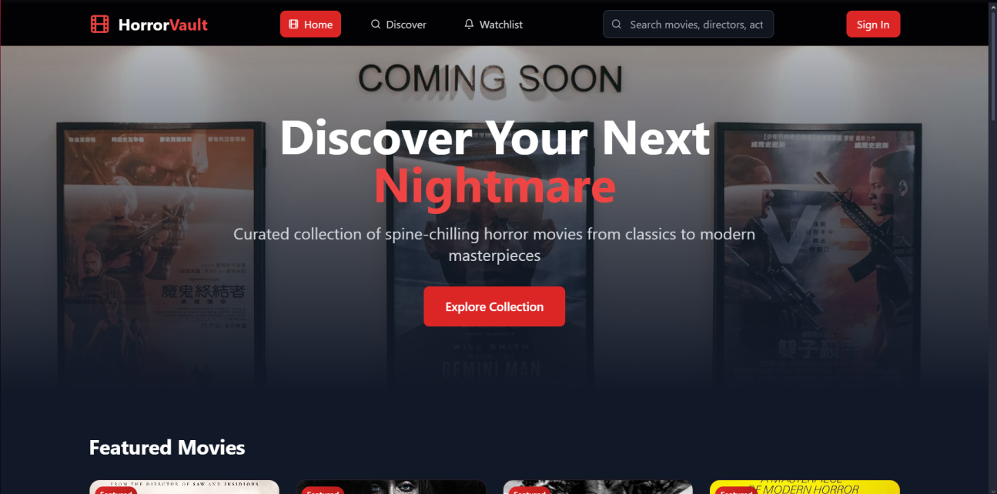
USER-FRIENDLY WEBPAGE
HorrorVault has a simple user interface, making it easy for viewers to search for horror films. HorrorVault is also an advertisement-free website, so viewers don’t easily get confused or annoyed by it.

Slide 7
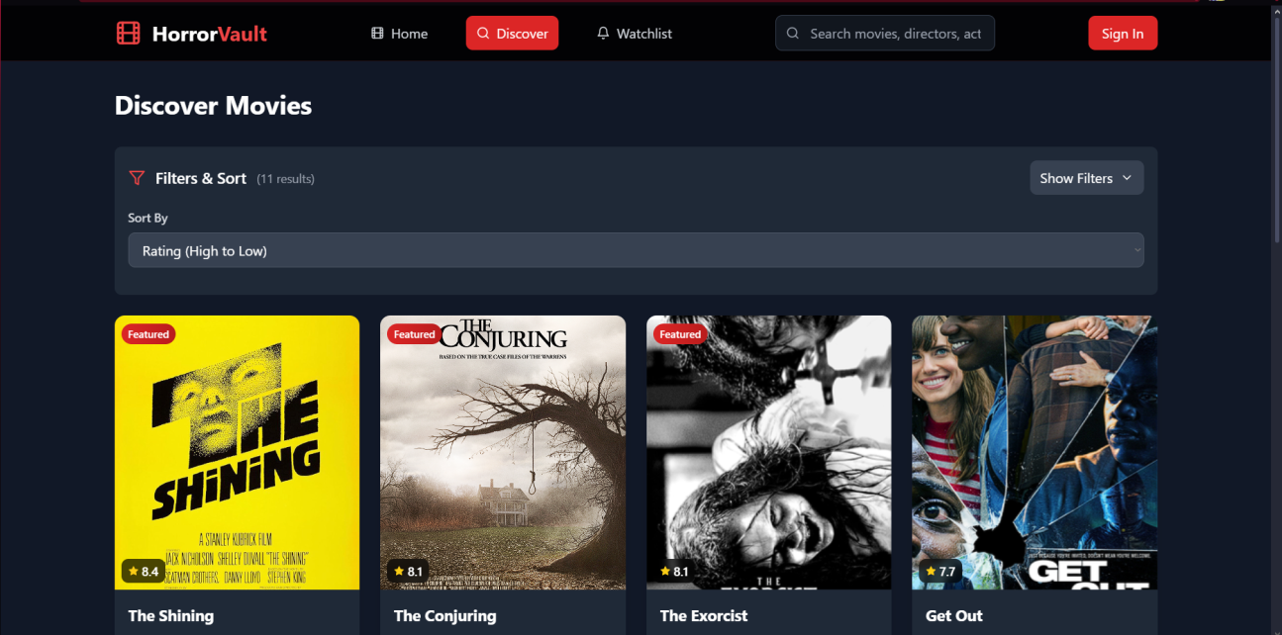
DISCOVER EVERY HORROR
HorrorVault has a broad collection of horror movies, from classics such as The Shining, to modern masterpieces like Midsommar. Whatever movie, you name it, HorrorVault has it all.

Slide 8
NEVER FORGET AGAIN
Have a goldfish memory? Worry no more, HorrorVault allows you to put all films that you desire to watch in a watchlist so you never have to bug out again.

Slide 9
FUTURE UPDATES
-Websites that stream the desired movie

Slide 10

THANKS!

